Slide 1
LLMs v. LCMs 4/14/26 Capstone Session
Jaysen Jensen
Nicholas Dhaliwal
Nicholas Mikhail

Slide 2
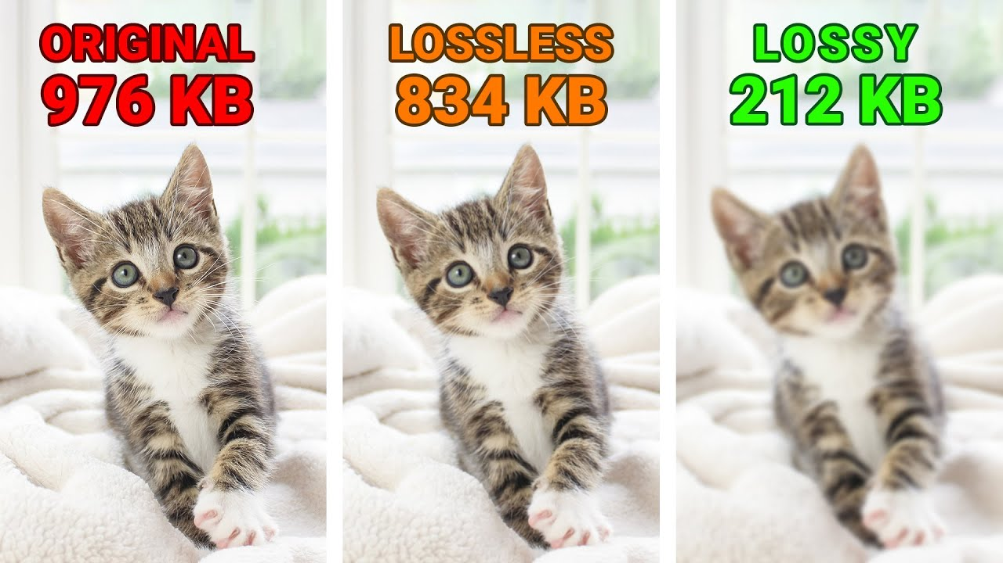
What is an LLM?
AI tools trained to understand, generate, and manipulate human language.
They are called “Large” because of the massive data used for training and the number of parameters.
LLMs are Probabilistic Prediction Engines
LLMs do not “lookup” an answer in a database, it calculate the probability of which token should come next based on patterns learned during training
Lossy Compression of Text Data found in Training Data
Source: Elegant Themes - YouTube
Large Concept Models (LCM) for Higher Level Reasoning

Slide 3
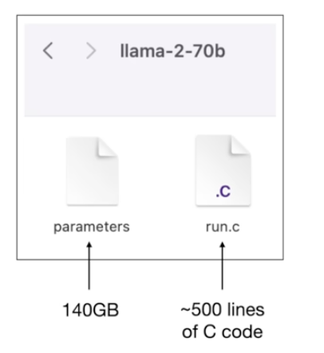
What is an LLM?
2 files:
Parameters (~140 GB, ~2 bytes per parameter)
Run file (C, python, etc.)
Built on the Transformer architecture introduced in Google’s 2017 paper, “Attention is All You Need”
Replaced recurrent and convolutional neural networks
Source: Andrej Karpathy - YouTube
Large Concept Models (LCM) for Higher Level Reasoning

Slide 4
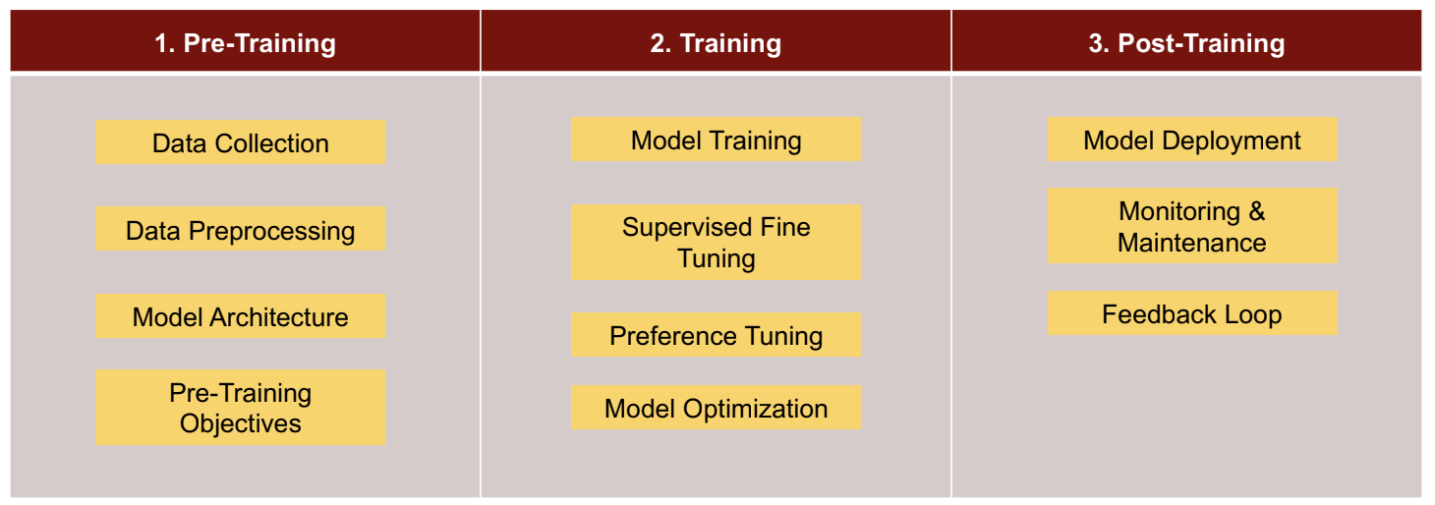
Developing an LLM
· Training: LLMs require massive compute (thousands of GPUs over weeks/months), driving costs from millions to $100M+ for frontier models.
· Maintenance: Ongoing costs include inference at scale, updates/retraining, and infrastructure which often exceed initial training costs over time.
Source: Ashish Pujari - NLP
Large Concept Models (LCM) for Higher Level Reasoning

Slide 5
Overview of an LLM Workflow
User enters a prompt
Prompt is split into tokens and are converted to embeddings
Positional information is added
Transformer layers process the sequence
Attention finds important relationships
Model predicts the next token
One token is chosen
Token is added to the response
Process repeats until the answer is complete
An LLM takes input text, converts it into tokens and numerical representations
These are processed through transformer layers with attention, predicts the most likely next token
Repeats that process until it produces a complete response.
Large Concept Models (LCM) for Higher Level Reasoning

Slide 6
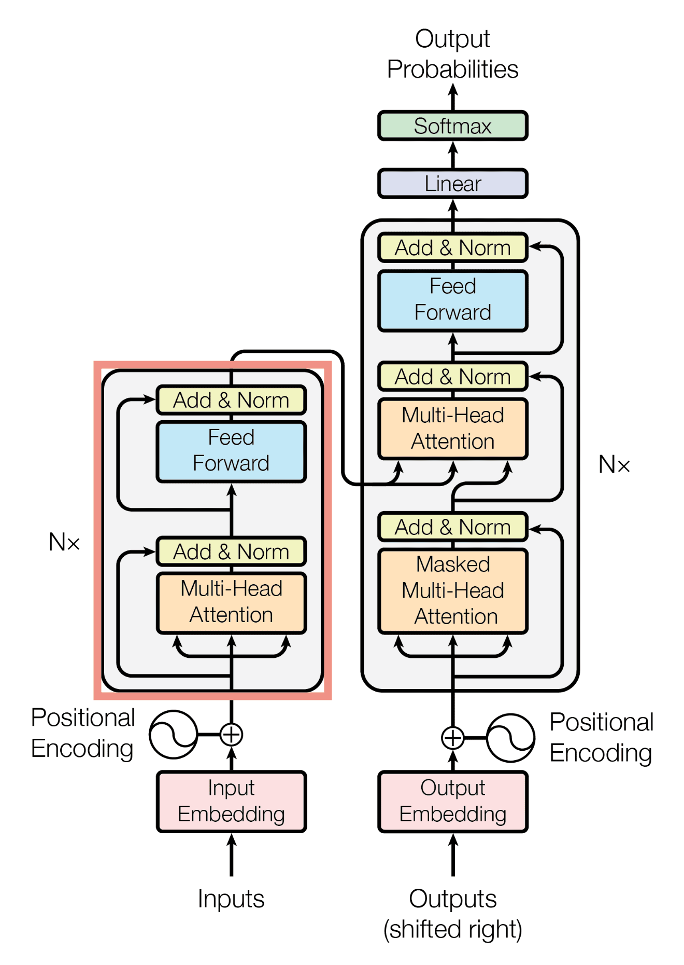
Transformer Architecture Overview
Parallel attention heads allow a Transformer model to simultaneously focus on different types of relationships between words in a sequence.
Multiple heads prevent the model from fixating on just one token or averaging out all information, which makes the model more robust to noise
Source: Attention is All You Need – Google
Large Concept Models (LCM) for Higher Level Reasoning

Slide 7
Next Token Prediction
Computes a probability distribution over all possible next tokens based on the input context
Selects the most likely (or sampled) token to extend the sequence and continue generation
Next-token prediction is not actual thinking; its probabilistic pattern matching…
Selecting the most likely next word based on learned statistical patterns, not performing genuine reasoning.
Source: Amgad Hasan - Medium
Large Concept Models (LCM) for Higher Level Reasoning

Slide 8
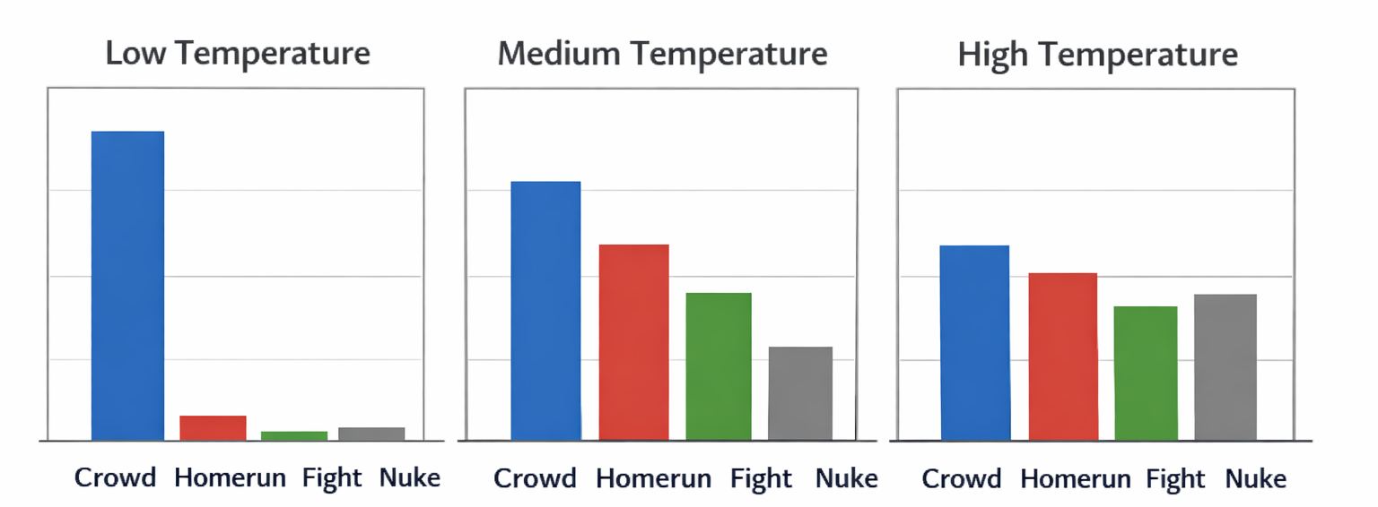
Next Token Prediction Example
At the baseball game there was a…
Token | Probability
Crowd | 0.50
Homerun | 0.30
Fight | 0.195
Nuke | 0.005
Large Concept Models (LCM) for Higher Level Reasoning

Slide 9

Limitations of LLMs in Law
LLMs often appear to reason in legal contexts, but they primarily match and recombine patterns from training data rather than perform true hierarchical analysis.
They can generate convincing outputs by retrieving and adapting familiar argument structures, giving the illusion of expertise.
Key risk for practitioners: failures are hard to detect, because responses are fluent, confident, and structurally similar to real legal reasoning.
LLMs only reason over the text currently in their context window. Limits their ability to:
Track long, multi-step legal arguments across documents
Maintain consistent reasoning over extended fact patterns
Image Source: Macie LaCau – The Real Daily
Large Concept Models (LCM) for Higher Level Reasoning

Slide 10
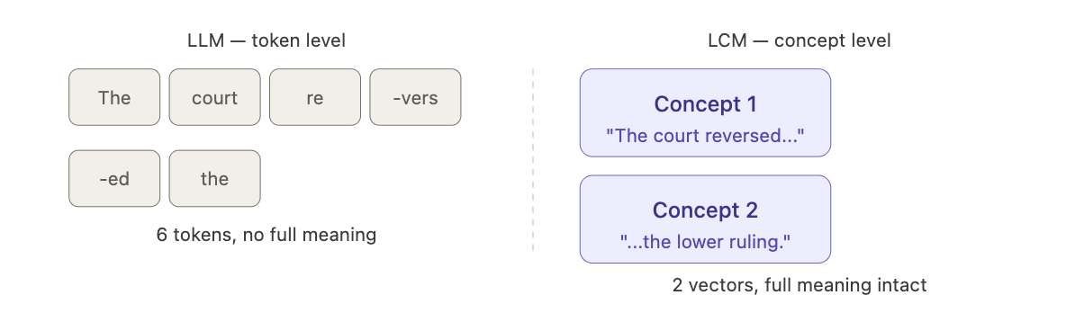
Introduction to Large Concept Models (LCMs)
LLMs read and generate one token (subword fragment) at a time. LCMs replace the token with a concept: a dense vector that encodes the meaning of an entire sentence.
Each concept is produced by SONAR which is a pretrained multilingual sentence encoder from Meta that maps any sentence, in any of 200+ languages, to the same semantic space
The LCM backbone is a transformer that operates on a sequence of these concept vectors instead of tokens, predicting the next concept vector autoregressively
The SONAR encoder and decoder are frozen. Only the concept-level transformer is trained.
Because reasoning happens in a language-agnostic space, a model trained in English generalizes to other languages zero-shot at inference time
Large Concept Models (LCM) for Higher Level Reasoning

Slide 11
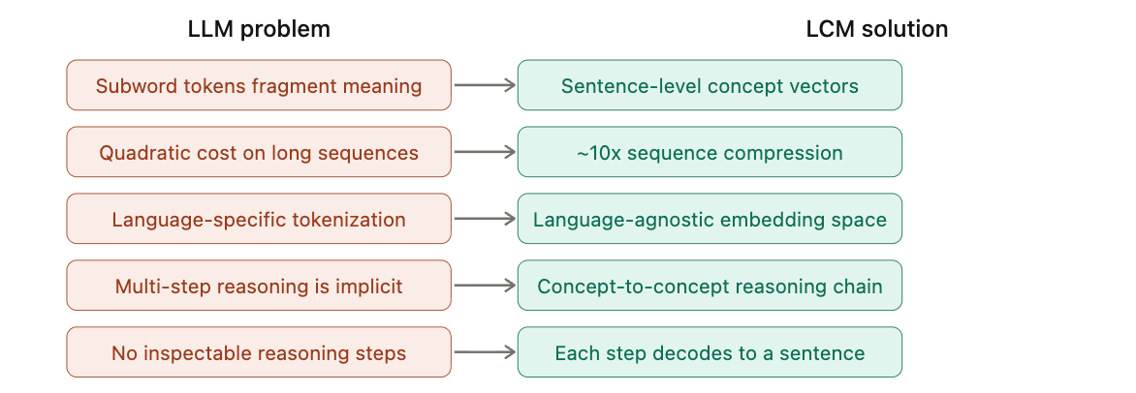
What Problems does an LCM Solve?
Token granularity: LLMs reason subword-by-subword with no native unit of meaning. LCMs reason over whole sentences where each computation step carries a complete idea.
Sequence length: transformer attention cost scales quadratically with length. Concepts compress sequences ~10x versus tokens, making long documents tractable.
Cross-lingual transfer: LLM tokenization is language-specific. SONAR embeddings are language-agnostic where an LCM trained in English can generate output in 200+ languages zero-shot.
Compositional reasoning: multi-step arguments are hard to encode token-by-token. At the concept level, logical dependencies between sentences are more directly represented.
Interpretability: every predicted concept vector can be decoded to a readable sentence. Token-level LLM internals have no such interpretive anchor.
Large Concept Models (LCM) for Higher Level Reasoning

Slide 12
Training a Large Concept Model
The SONAR encoder and decoder are pretrained on multilingual parallel data and frozen. Only the concept transformer is trained.
Objective: given a sequence of concept vectors, predict the next one. Loss is the distance between the model's predicted concept vector and the ground-truth SONAR embedding of the actual next sentence.
This is continuous supervision where the loss measures how wrong the predicted meaning is, not how wrong the predicted word is.
Large Concept Models (LCM) for Higher Level Reasoning

Slide 13
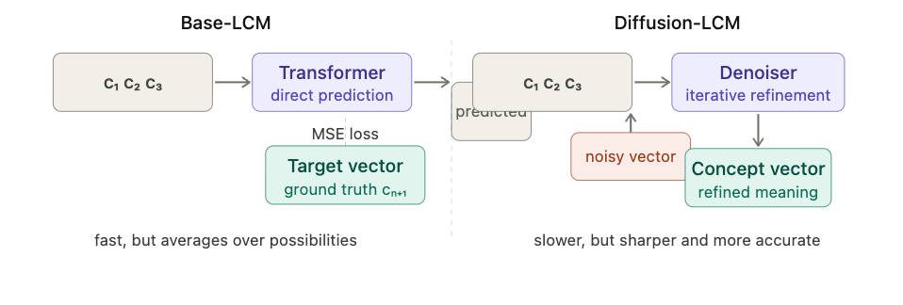
Training a Large Concept Model – Variants
Two training variants from the Meta paper:
Base-LCM: directly minimizes MSE between predicted and target concept vectors. Simple, but tends to average over plausible continuations and produce generic output.
Diffusion-LCM: starts from a noisy concept vector and iteratively denoises it toward the target, conditioned on prior context. Handles the multimodal distribution of plausible next sentences better and outperforms Base-LCM on generative tasks.
Large Concept Models (LCM) for Higher Level Reasoning

Slide 14
Drawbacks of Large Concept Models
Segmentation dependency: pipeline assumes clean sentence boundaries. Malformed or domain-specific text (legal clauses, code, lists) that doesn't parse cleanly degrades concept quality before training even begins.
Decoding fidelity: reconstructing precise text from a predicted embedding is lossy. Fine-grained lexical precision can be lost in the encode-decode cycle.
Fixed granularity: sentence boundaries are a human-defined prior, not a learned one. The model cannot adapt its segmentation to information density (e.g. a dense technical clause and a simple filler sentence are treated identically)
Initialization cost: SONAR required large-scale multilingual pretraining before LCM training can begin, raising the total pipeline cost above a standard LLM.
Evaluation gap: standard NLP metrics (BLEU, perplexity) are token-level. There are no established concept-level benchmarks, making rigorous comparison to LLMs methodologically difficult.
Maturity: the architecture is pretty nascent w/ limited tooling, few independent reproductions, no established fine-tuning or domain adaptation practices.
Large Concept Models (LCM) for Higher Level Reasoning

Slide 15
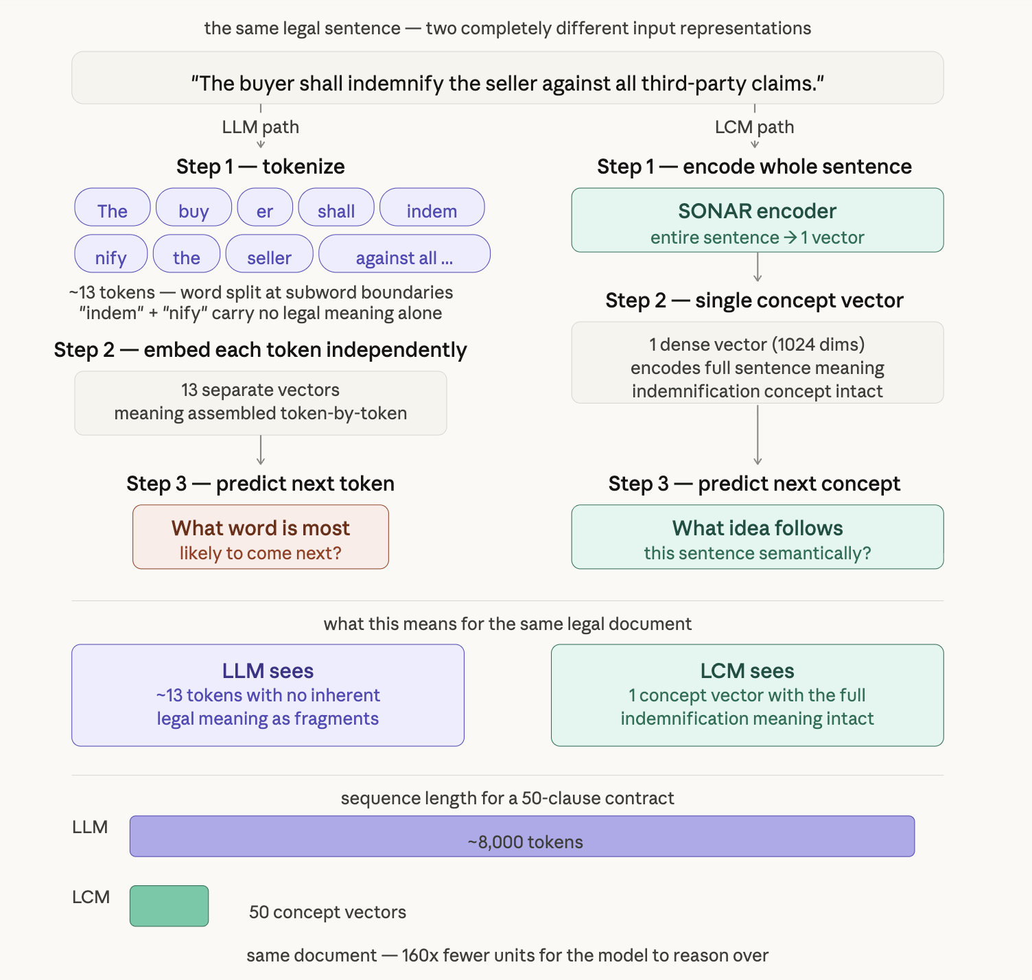
Input Unit Comparison
LLMs read subword fragments (e.g. "indemnification" → ["indem", "nif", "ication"]) — legal meaning has to be reconstructed from pieces that carry none of it independently
LCMs read whole sentences as a single concept vector — legal meaning arrives intact, nothing is fragmented
A 50-clause contract = ~8,000 tokens for an LLM vs. 50 concept vectors for an LCM — 160x fewer units, meaning distant clauses stay connected instead of fading
Legal drafting is already structured around discrete units of meaning — clauses, provisions, holdings — making LCMs the first architecture whose atomic unit actually matches how law is written
Large Concept Models (LCM) for Higher Level Reasoning

Slide 16
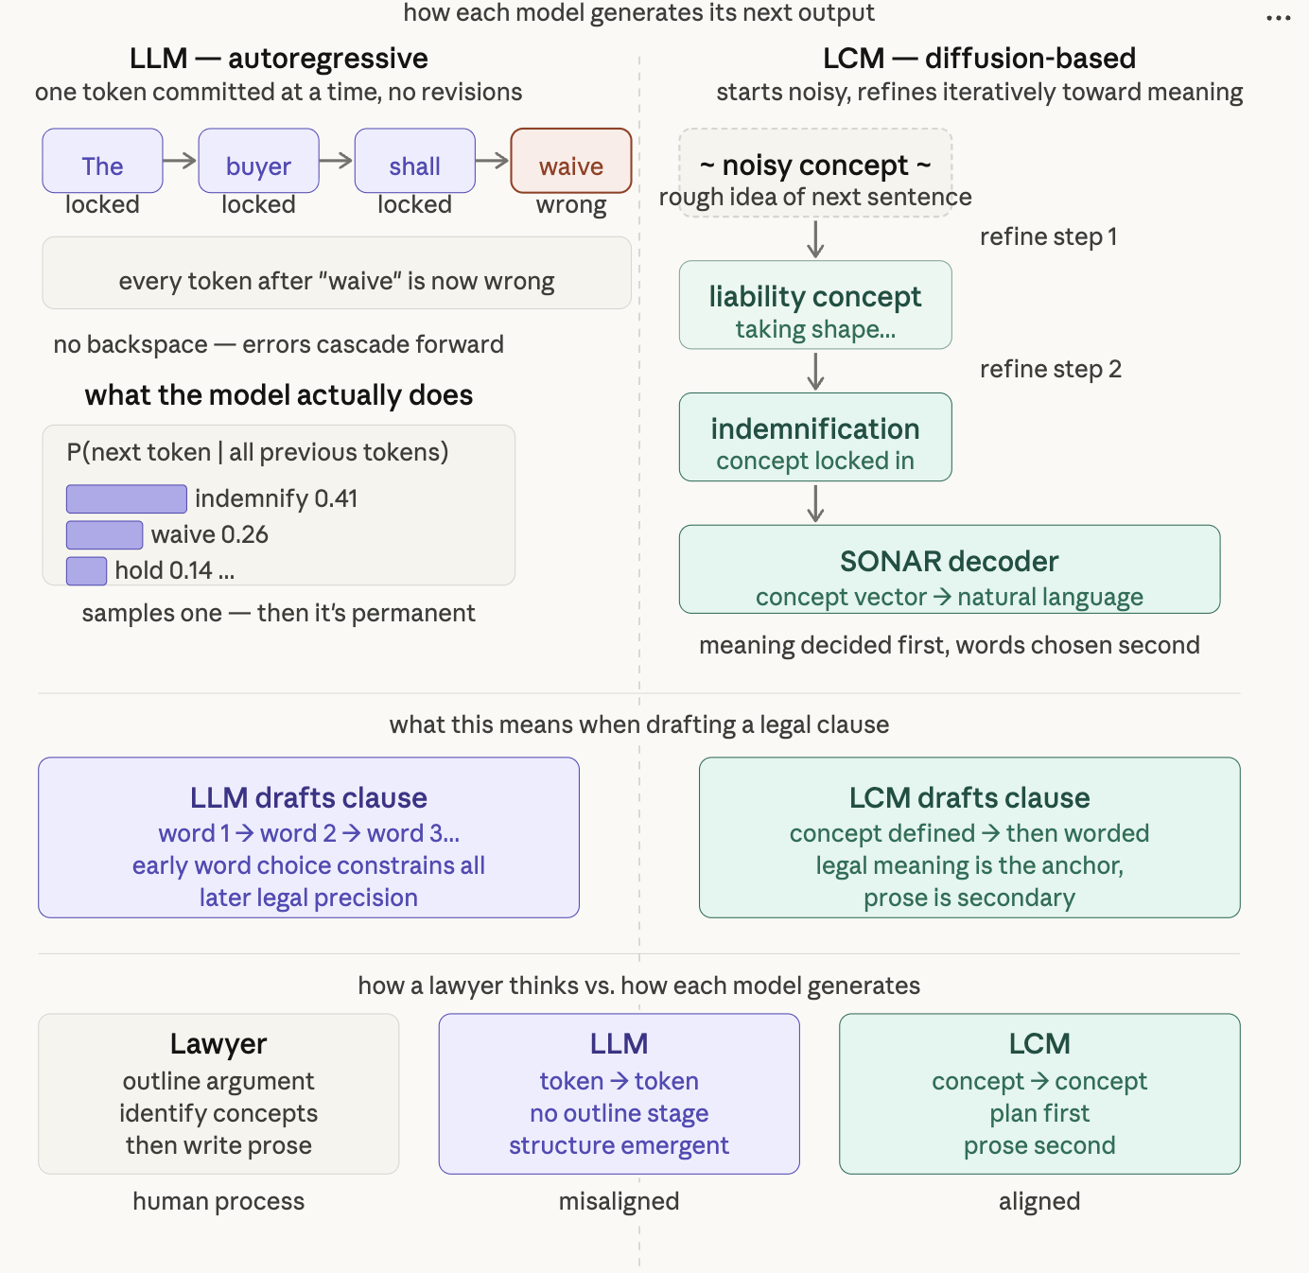
Generation Mechanism
LLMs generate one token at a time, permanently — each word is committed before the model knows where the sentence is going.
A wrong word early in a clause shifts every token that follows — errors don't stay local, they cascade and compound through the entire output
LCMs start with a noisy concept vector and iteratively refine it — like developing a photograph, the idea sharpens across multiple steps before a single word is written
Legal meaning is decided before prose begins in an LCM — the SONAR decoder only converts the concept to language once the meaning is locked in
This mirrors exactly how lawyers are trained to think — IRAC: concept first, writing second. LLMs do the opposite. LCMs do it in the right order.
Large Concept Models (LCM) for Higher Level Reasoning

Slide 17
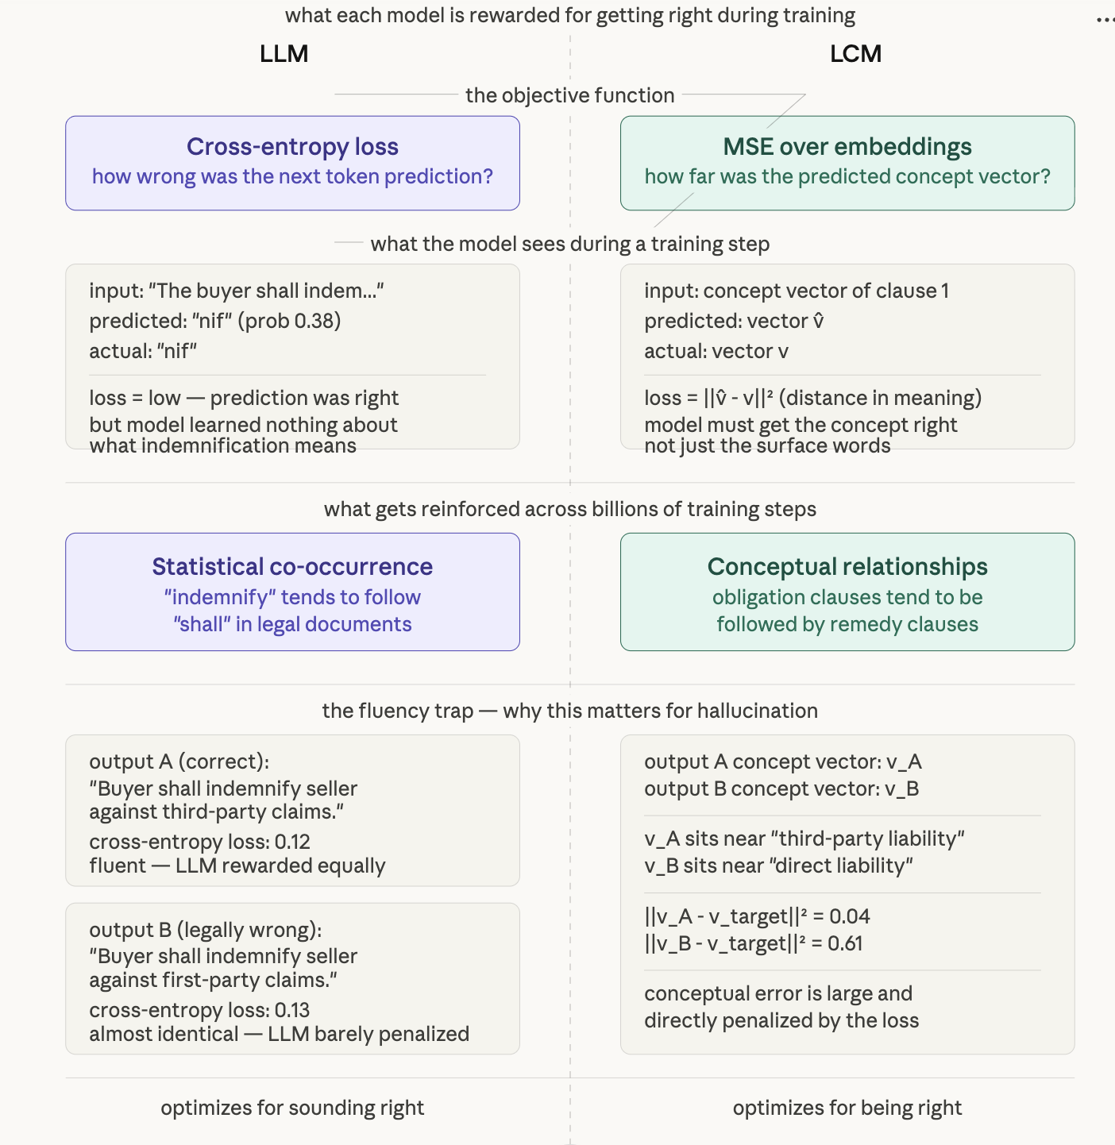
Training Objectives
LLMs optimize for statistical plausibility — the loss function has no concept of truth, accuracy, or legal correctness
A legally wrong clause in fluent legalese receives almost identical loss to a correct one — wrong meaning is invisible to the training signal
LCMs optimize for conceptual accuracy — loss is the distance between the predicted idea and the actual next idea in semantic space
EX: Third-party" vs. "first-party" claims: one token apart, but worlds apart in meaning — cross-entropy misses it, MSE catches it
LLMs learn the texture of legal language. LCMs learn the logic of it.
LLMs are trained to sound like legal experts. LCMs are trained to think like them.
Large Concept Models (LCM) for Higher Level Reasoning

Slide 18
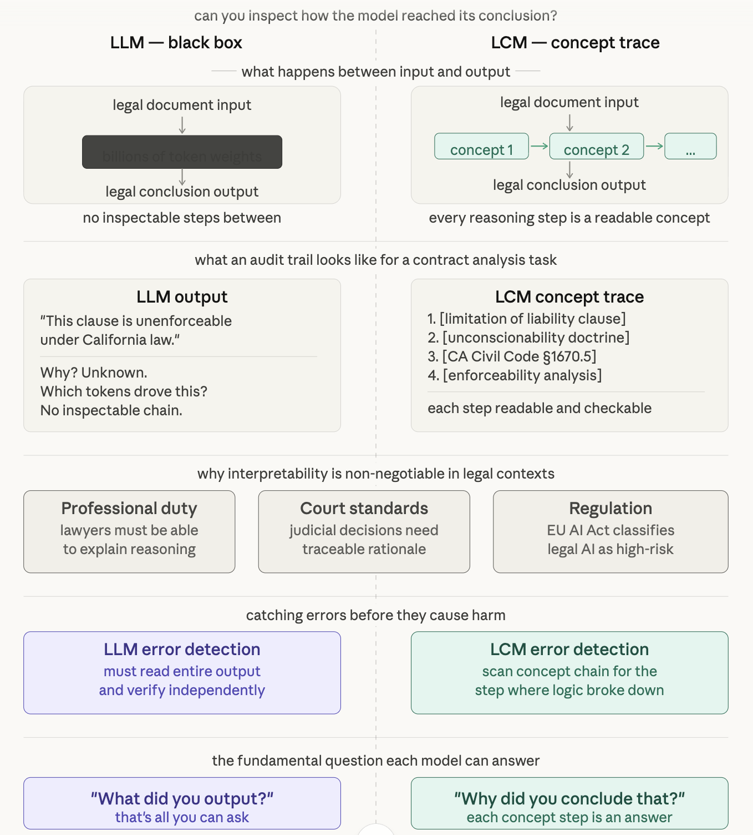
Interpretability
LLM reasoning is distributed across billions of weights firing simultaneously — there is no single inspectable step you can point to and say "this is where the conclusion came from"
LCMs produce a readable concept chain — each step can be decoded into plain language, making the reasoning the computation itself, not an approximation
Law requires explainability at every level: professional responsibility, court scrutiny, and the EU AI Act all demand auditability that black-box LLMs cannot meet
LLM errors: read everything, verify independently. LCM errors: find the exact concept step where logic broke down
LCMs aren't just more accurate. They're more compatible with how law actually works.
Large Concept Models (LCM) for Higher Level Reasoning

Slide 19
Research Question & Paper Structure
How can Large Concept Models overcome the architectural limitations in Large Language Models to enable higher-level strategic reasoning and traceable decision-making in complex domains like Law?
Abstract & Research Motivation: Identifying the 'Reasoning Gap' in LLMs
LLM Architecture: Analyzing current construction and higher-level reasoning limitations
Introduction to Large Concept Models (LCM): Moving from next-token to next-concept prediction
LCM Advantages: Improving performance & interpretability through reasoning tracing and edge/node mapping
Hybrid Architecture: Leveraging LLMs as a linguistic layer over Concept Model reasoning
Legal Case Study: Applying CM to complex strategic tasks and long-form legal reasoning
Implementation Blueprint: Technical schematics and data sourcing for CM prototypes
Future Horizons: Post-processing challenges and experimental validation in industry
Large Concept Models (LCM) for Higher Level Reasoning

Slide 20
Thank You
Jaysen Jensen – jaysen@uchicago.edu
Nicholas Dhaliwal – nicholasdhaliwal@uchicago.edu
Nicholas Mikhail – nmikhail@uchicago.edu
Large Concept Models (LCM) for Higher Level Reasoning

Slide 21
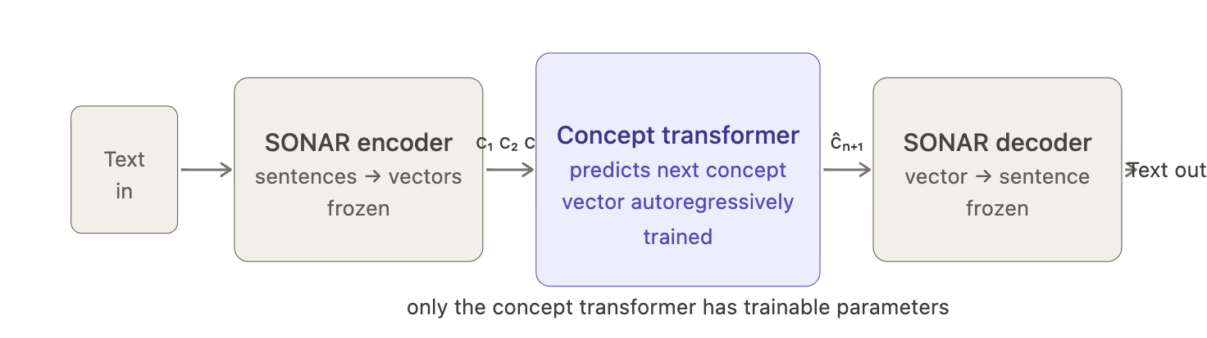
LCM Architecture Overview
Encode: Input text is split into sentences. Each sentence passes through the frozen SONAR encoder, producing a fixed-size concept vector. A 10-sentence document becomes 10 vectors.
Concept transformer: The sequence of concept vectors is fed to the LCM backbone which is a causal transformer that predicts the next concept vector. All reasoning happens here.
Decode: The predicted concept vector passes through the frozen SONAR decoder, which generates the output sentence in any supported language.
Large Concept Models (LCM) for Higher Level Reasoning

